Slide 1

The R.A.P Connection March/April.2012 Volume 51 The Official Publication Editor: Mary Lerkins
Officers
Margie Brumfield- President
Mary Lerkins-
1st Vice President
Angelina Rivera-
2nd Vice President
Natalie Vazzana-
Secretary/Treasurer
30 N.Union St., Suite 203, Rochester, NY 14607
Office- 454-1380
Fax- 454-1383
http://ny.aft.org/rap
Executive Board Members
Paul Pittinaro- Board Chairperson
Jewell Brown
Kenneth Lord
Cedric Moorehead
Terry Spiva
Linda Thompson
Dorothy Tisdale
Maryann Tychoniewicz
Rosemary Wilson
From the Desk of the President:
URGENT: HMS Independent Audit:
The City School District is aware that you have not completed the
Dependent Audit process conducted by HMS Employee Solutions. You
have either not responded or have partially responded to the request
from HMS. Documents are needed to verify that your dependents are
eligible to be covered under the RCSD health plan.
If you have NOT completed the process you need to do so by sending
the requested information to HMS. Another letter will follow. Thank you
for your attention to this matter.
SBPT:
It is vitally important to have a RAP representative on the School Based
Planning Team. The Team should have every constituency represented,
particularity those who deal directly with students. Please choose a representative to serve on the Team and consider sharing the responsibility.
out of sight, out of mind. Please don’t Jeopardize losing this seat. It is very
important to know what’s going on and to use your voice to represent your
own constituency.
Teaching Assistants:
HCI has called back a few more TA’s to TA positions. We expect that several
more will be put back in TA positions next year in the 12:1:1 classrooms.
Transfer Day:
RAP is expecting transfer day possibly the last in May.
Staffing:
RAP has been invited back to take part in the staffing process in April. This is to know it is done according to the contract language.
From the Desk of the 1st Vice President:
United Way Campaign:
We would like you encourage all of our members to support the United Way. It is so easy to do. The donation can be taken out of your pay or send a one time payment. The RCSD has a very good participation, be part of that reputation.
Please consider a donation, you or someone you know could benefit from the United Way Fund(see flyer inside).
Name or Address Change:
We would like to remain anyone who changes vital information that it is your responsibility to inform all parties necessary. For the district you need to go into the Peoplsoft and amend your personal information. For RAP you need to call or send your new information. The District does NOT provide us with changes. We still have members that were laid off that we still can’t get in touch with because all their information
Is wrong. For TA’s, the State needs to be informed, you could jeopardize losing your certification.

Slide 2
From the Health, Wellness & Safety Committee-Maryann Tychniewicz, Chairperson
FOOD DRIVE to benefit FOODLINK
Now through April 27th
Collect new nonperishable items(no glass)
(canned goods, juice boxes, snack bars etc….)
Drop-off at RAP Office- 30 North Union St. or Call for pick-up(454-1380)
Let’s get as many donations as possible-get involved!!!!!
From the Desk of the 2nd Vice President:
Public Relations Committee:
We are proud to say that we had three great celebrations this year. Our last event was the Black History/Women Celebration. We enjoyed delicious food from S&T Lounge.
Tiffany Bumphis from #5 School sang for us and was great as always. Kenneth Lewis(a student from the Inner City Poetry and Performing Arts) working with Rose Wright from #29 School, also gave an awesome presentation. Thank you for your time and for sharing your talents with us! Ann Culbreth from #33 School, presented a Power Point piece, celebrating and honoring some important African Americans and Infamous Women. Great job Ann! We had a
good group of members that worked and celebrated very well together. Oh, and we also got in a little line dancing. Just remember that we do these events so we can socialize and have fun in a different environment. The Committee is looking for NEW member participation and new ideas. If you are interested in working with us for next year call the RAP Office(454-1380) and let us know.
Grievance Committee:
This year we have had many grievances. Some of these grievances could have been avoided if we had followed our contract and the District Code of Conduct Policies. We take all complaints and grievances very seriously and always try to settle a concern at the lowest level possible(Building). It is very important to conduct ourselves in a professional manner all the time. We are educators and role models for our students. Please, let our actions and words be a reflection of our good character and the commitment that we have to our students and our jobs. We are her to help you in any situation, if in doubt call the office for clarifications right away.
From the Desk of the Treasurer:
VOTE-COPE:
VOTE-COPE contributions cards have been sent to all RAP members and retirees. Please read the VOTE-COPE flyer which details what VOTE-COPE is and its importance.
I would like to say that, as public employees, almost all conditions affecting our professional environment, working conditions and pension rights are determined by the actions of the New York State Legislature, the Governor, and the US Congress. If we wish to have a positive influence on our professional future, we must take an active part in the political process. You can make your voice heard, and at the same time make an investment in your future, by contributing to VOTE-COPE, NYSUT’s political action fund.
I strongly urge you to contribute(whatever you can) to VOTE-COPE, and invest in your future.
Health, Wellness & Safety Committee…
Maryann Tychoniewicz, Chairperson
Food Drive:
RAP is hosting a food drive for Foodlink. We need our members help to make it a success! Foodlink relies on people like us to help feed approximately 150,000 hungry people in and around the Rochester area. Every donation helps in fighting hunger in our community. This food drives starts NOW and will continue until April 27th. You can help as individual members or make it school wide activity. Donations can be dropped off at the RAP Office or call (454-1380) to schedule a pick up at your building.
We are looking for new original unopened nonexpired dated packages. No glass or homemade
Items will be accepted.
Give what ever you can- Foodlink will be grateful for any donations.
Passages
We have sad news to report. A couple of our members have recently passed away. All of which were unexpected. It is very hard on both the students as well as the staff when this happens. The members are Brenda Jackson,1/21, Northeast Prep, Janice Cooper,2/25,Edsion Bus., Janice Brady,2/29
#6 School. Our sympathy to all of the family, colleagues and students.

Slide 3

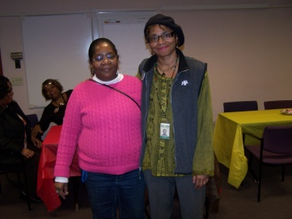
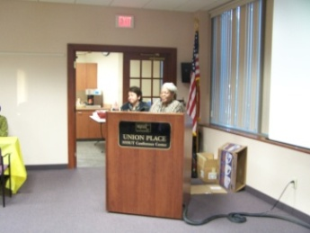
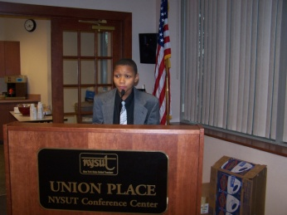
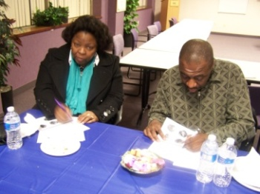
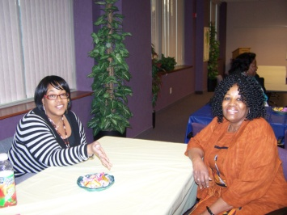
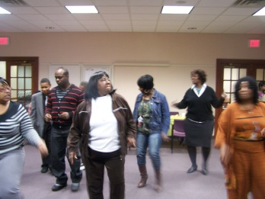
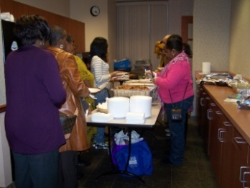
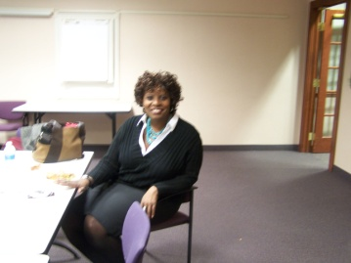
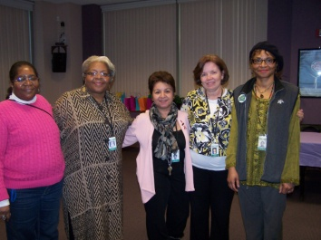
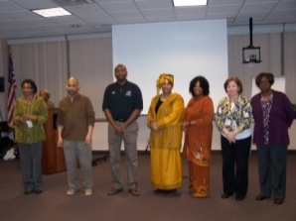
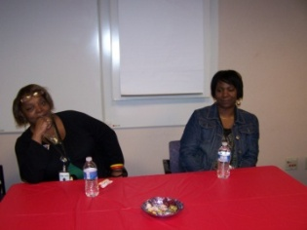
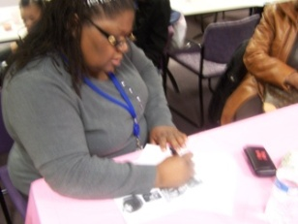
Calendar of Events:
March 22nd Board of Education Women’s History
Month Observance 5:30pm –Business
Meeting 6:30pm @ Central Office
April 6th Good Friday (paid Holiday)
April 9th-13th Spring Recess
April 26th Board of Education Business Meeting
6:30pm @ Central Office
RAP’s National Union Affiliations
NYSUT and AFT, provide ads which offers different opportunities for our members. Please check out all the benefits at their websites. www.aft.org and www.nysut.org
Black History and Women’s History Celebration
Black History Celebration at #29 School
Submitted by Mrs. Margaret Doyle,TA
On February 17th, School #29 had a Black History Celebration. Our students performance was awesome! They all showed exceptional gifts and talents. Our Junior Choir was over the top. It was directed by Mrs. Selena Johnson.
After the celebration came the luncheon. What a luncheon it was! It consisted of fried chicken, collard greens, green beans, macaroni-cheese, pound cakes, and soft drinks. The food was delicious!
At #29 School, our main focus is purely on the students. The main reason for our Black History Celebration/Luncheon is to showcase our talented students. The proceeds from the luncheon will go to bless one or more of our students who has shown academic excellence, superior behavior, and who have expectations of greatness. Our scholarship award is called the “Kenneth Barnes Scholarship Award”. The announcements of our big winners will be forthcoming. A big thank you goes to Mrs. Selena Johnson, Mrs. Lewis, and Ms. Wright for their tireless contributions of their time and money to make this program a success. We look forward to an even greater performance next year.
President Margie Brumfield and 2nd VP Angie Rivera welcoming everyone to the celebration.
Orator Kenneth Lewis, #29 School. He recited a speech
From Dr. Martin Luther King,Jr
Hazel King,#2 “ Did you know we would have to play trivia for dinner?” Rodney Major,#2 “ I think it’s for a prize!”
Tiffany Bumphis,#5 (singer)and her mother, Dorothy Tisdale,#8 waiting
patiently to be called for the dinner. “Lets eat, Lets eat…….”
Who said we don’t support the Health and Wellness policy. Line dancing counts. Let’s move!!!!!
Great food made by S&T Lounge. There is always second helpings for everyone.
Our wonderful NYSUT Labor Relations Specialist , Shelly Clements came to enjoy the celebration and to mingle with our members. Thanks for coming.
Gertrude Barnwell, Margie Brumfield , Angie Rivera, Mary Lerkins, Ann Culbreth thanks for all your help to make it happen.
Some of our Board of Directors, Retirees, and members enjoying the celebration. Thank you for supporting RAP.

Slide 4

Happy Birthday from R.A.P!! According to RAPS latest Information
MARCH 2012
Sarah Rosas Vivian Haynes
Willie Young Susan Spector
Mary Dukes Michelle Douglas
Lynda Harris Nitza Gonzalez
Chenesta Hopkins Ann Bocianski
Sheila James Tradene King
Akilah Moore Tine Seabon
Cynthia Gladney-Caldwell Carolyn Jackson
Kathleen Sobers Karen Ostrowski
Luis Perez Edwin Torres
Nydia Burgos Michelle Floyd
Linda Gillette Patricia Ivy
Paul Pittinaro Kathleen Higbee
Laurie Aubel Kristin Ashford
Eric Kittles Deborah Wingate
Daniel Santiago Shaunte Johnson
James Smith Deborah Kendrick
Mary Knapp Marlene Nevison
Finesha Benjamin Wanda Vargas
Kathleen Giehl Alicia Law
Ivy Hicks-Ivey Glenda Powell
Lillian Ruiz Ann Thompson
Carmen Shepard
APRIL 2012
Anthony Andrews Tracy Cooper
Gloria Cooper Charmaine Dobbs-Geeter
Andilene Humprey Deborah Lewis
Adriene Murray Charles Small
Jessica McCarty Mary Marianetti
Mary Terry Doris Osborne
LeeAndrea Carlton Addie Reaves
Elba Sanchez Migdalia Arroyo
Sheila S. Anderson Rosa Gosier
Amanda Coleman Solomon Muhammad
Virginia Rivera Shirley Rivera
Stephanie Williams Rosa Estrella
Jewell Brown Marion Hall
James Tomkinson Valerie Williams
Lisa Adkins Janet George
Joseph Federico Gary Wilson
Abigail Rodriguez Elsie Correa
Violeta Velazquez Johnnita Jackson
Carmen Betancourt Carmen Delgado
Mary Ingrassia Ollie Owten
Mariano Velazquez Angelina Rivera
Patti DeCarlo
Useful links to have--------
www.educatorsEAP.com
You can take self-improvement classes
www.myexcellusplan.com/rcsd
Healthy Rewards program
www.stopbullying.gov/
www.letsmove.gov/
New York State Assessment Test Date
June 9, 2012 Registration Deadline May 4, 2012
Late Registration- May 18, 2012
July 14, 2012- Registration Deadline June 8,2012
Late Registration-June 22, 2012
To register online: www.nystce.nesinc.com

Slide 5
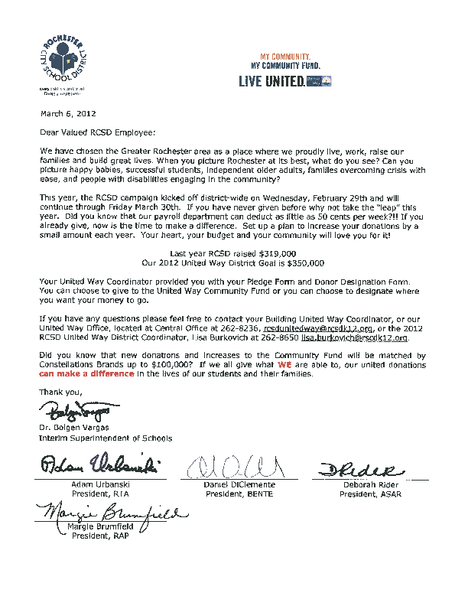

Slide 6


